Slide 1
Capstone Project
Telecom Churn Analysis

Slide 2

Steps Involve in Telecom Churn Analysis
1. Defining Problem Statement
2. Data Summary
3. Dependent Variables
4. Preparing Data for EDA
5. Univariate Visualization
6. Multivariate Visualization
7. Conclusion
8. Recommendation

Slide 3
Problem Statement
Exploring and analysing the data to discover key factors responsible for customer churn

Slide 4
Data Summary
Dataset Name :- Telecom Churn
Shape of the Data :- the dataset contain 3333 rows and 20 columns
Columns :- State, Account length, Area code , International plan, Voice mail plan, Number vmail messages, Total day minutes, Total day calls, Total day charge, Total eve minutes, Total eve calls , Total eve charge, Total night minutes, Total night calls, Total night charge, Total intl minutes, Total intl calls , Total intl charge , Customer service calls, Churn

Slide 5
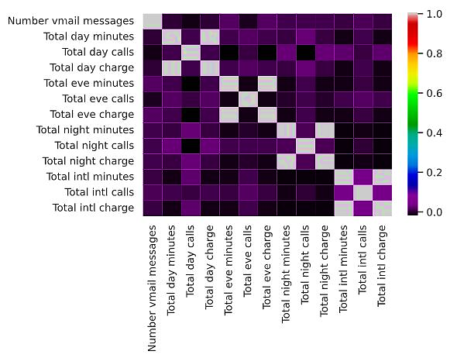
Dependent Variables
There are four dependent
variables:-
1. Total day charge
2. Total eve charge
3. Total night charge
4. Total intl charge

Slide 6
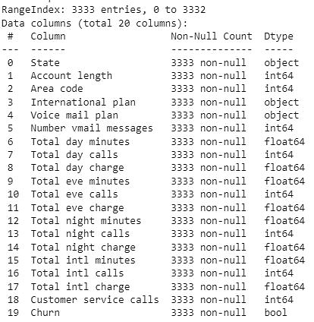
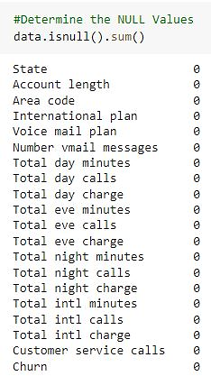
Preparing Data for EDA
Values of All Variables are already in proper format
There are zero null values

Slide 7
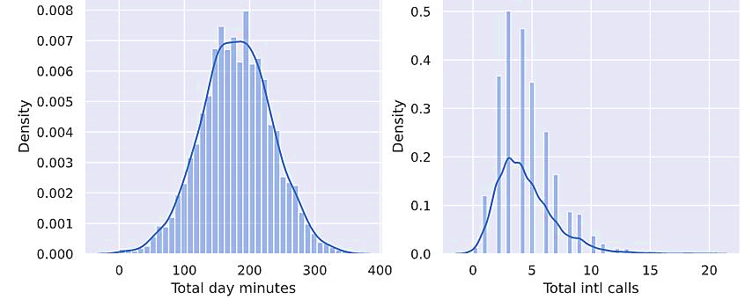
Univariate Visualization (Density plot)
Knowing the distribution type of features is very important when we use machine learning methods. In below plots ‘total day minutes’ is normally distributed, but the 'total intl calls' is positive skewed .

Slide 8
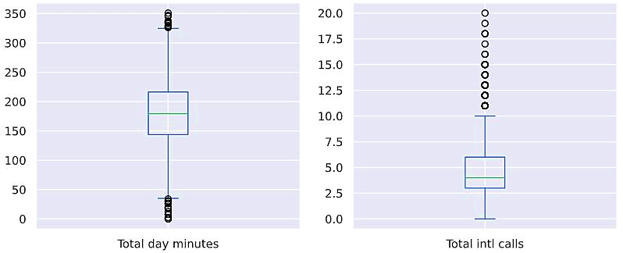
Univariate Visualization ( Identifying The Outliers)
The values that are fall out of the range , represented by black circles are called outliers. In below plot we can see that the international call are less in our dataset.

Slide 9
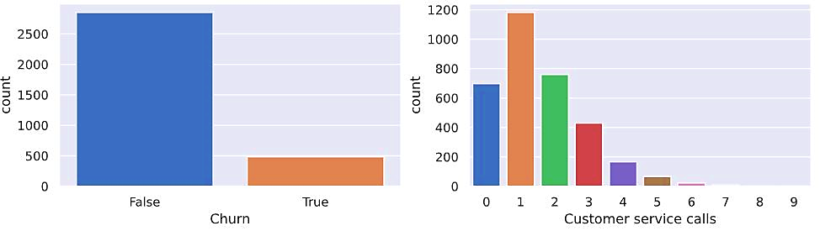
Univariate Visualization ( Frequency table )
We can see that small portion of customers are dissatisfied and by right plot it seems that most of the customers problems are solved in 2-3 calls.

Slide 10
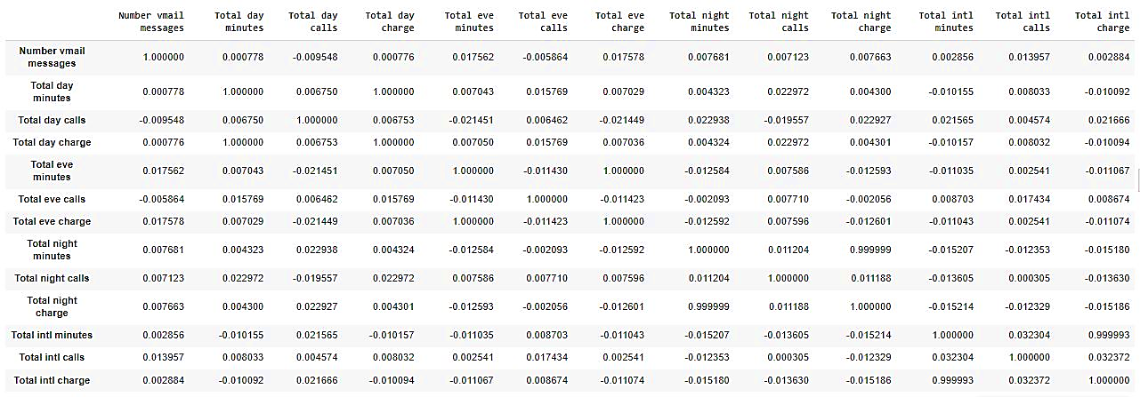
Multivariate Visualization ( Quantitative-Quantitative )
Correlation matrix between Quantitative Variables.

Slide 11
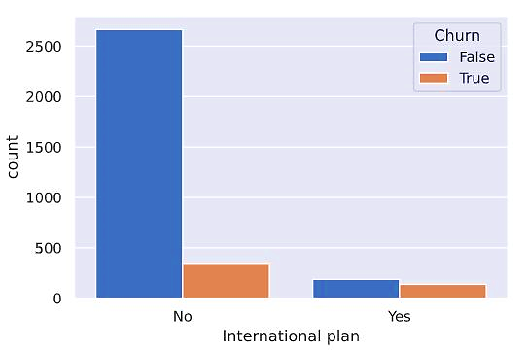
Multivariate Visualization ( Categorical-Categorical )
When International Plan is enabled, the churn rate is much higher

Slide 12
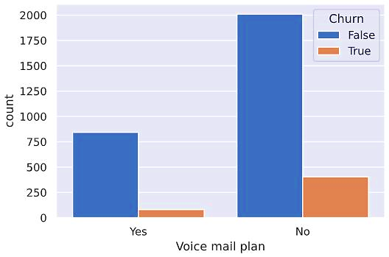
Multivariate Visualization ( Categorical-Categorical )
The Churn rate is high when the Voice mail Plan is not enabled. Therefore it seems that customers wants voice mail feature.

Slide 13
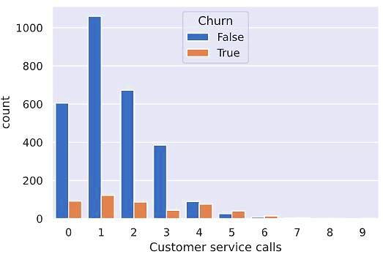
Multivariate Visualization ( Numerical-Categorical )
The churn rate increases significantly after 2-3 calls to the customer service calls

Slide 14
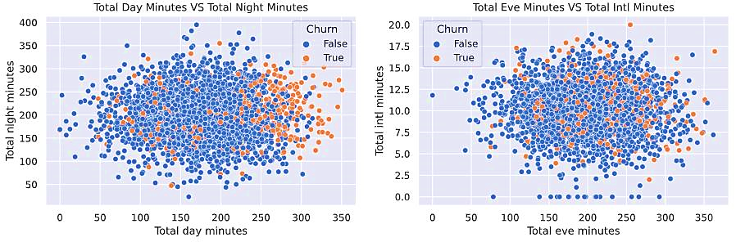
Multivariate Visualization (Quantitative - Categorical)
It seems on average, customers that discontinue their contracts are more active users of communication services in day as compare to other instance

Slide 15
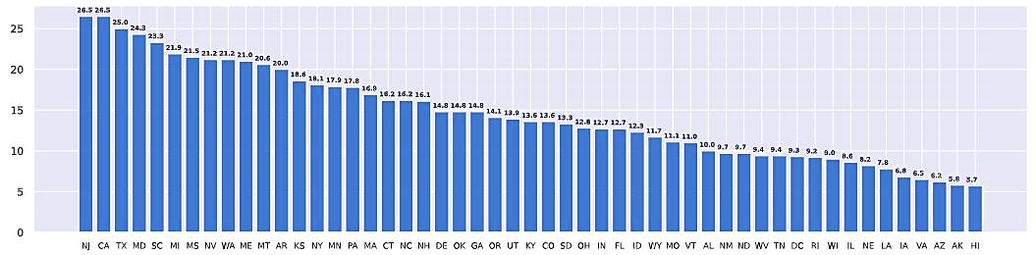
Multivariate Visualization (Quantitative-Categorical)
The states NJ(New Jersey) and CA(California) have highest churn rate of grater then 26% and HI(Hawaii) have lowest churn rate of less the 6%

Slide 16
Conclusion
1. Most of the Customers who disconnect their connections are very active user of communication service.
2. The rate of Churn more in those customers that enable International Plan as compare to those customers that doesn’t enable the International plan.
3. It seems that the rate of churn in those customers that doesn’t enable any
Voice mail plan are more.
4. Most of the customers problems are solved in 2-3 calls but after 2-3 calls the customers that still having any problem they seems to unsubscribe their plans.

Slide 17
Recommendation
1.Since most of the customer churn come up by a communication service, So I
think company will need to undertake additional economic analysis to find out
whether such measures would be beneficial.
2. There is also required some Improvement in international service and
also require some new low budget Voice mail and International plans.
3. It Seems that the some of the customer’s queries are not solved even after 4 customer service calls. So, highly recommend you to improve your customer service calls.

Slide 18
Thank you

